Slide 1

Analysis on movies dataset
DATA ANALYSIS AND MACHINE LEARNING USING PYTHON INTERNSHIP
TEAM: FLIXERS
MADE BY: ISHANI

Slide 2

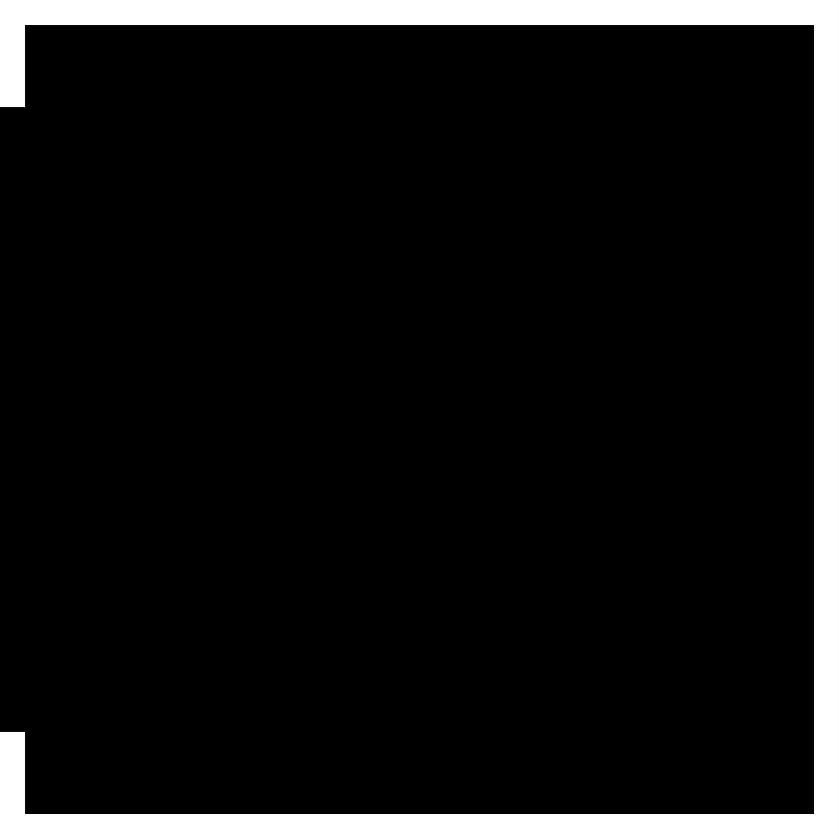
OUTLINE
PROBLEM STATEMENT
OBJECTIVE
MOTIVATION
DATASET DESCRIPTION
DATA PRE-PROCESSING
DATA VISUALIZATION
MACHINE LEARNING MODEL

Slide 3

PROBLEM STATEMENT

Slide 4

Problem statement
1.The idea behind this project is to find and compare between the accuracies obtained from different Machine Learning Algorithms.
2. To depict the overall distribution of movies according to Genre.

Slide 5
objective

Slide 6
OBJECTIVE
The objective of the project is to have an idea of deviation of different reviews by critics and users from IMDB ratings of corresponding movies, so that in future IMDB rating can be predicted on the basis of the reviews and further making possible recommendations.

Slide 7
MOTIVATION

Slide 8
MOTIVATION
Prediction of IMDB ratings on the basis of other means like genre, user's votes, reviews both by users as well as critics can be very helpful in details recommendations like Netflix and Amazon prime. For the people who are very specific with their taste in movies, the machine helps them to see exactly what the want to see.

Slide 9
DATASET DESCRIPTION

Slide 10
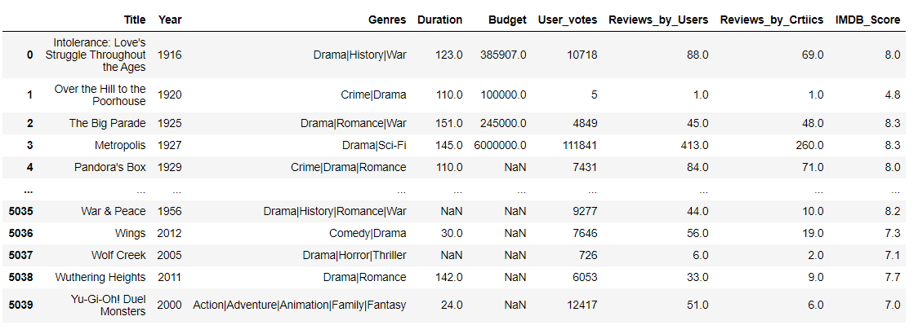
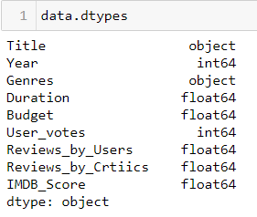
Dataset description
This dataset is taken from Kaggle.
There are 5040 rows and 10 columns.
The attributes are as follows:
Title
Year
Genre
Duration
Budget
User Votes
Review by Critics
Review by Users
IMDB Score

Slide 11
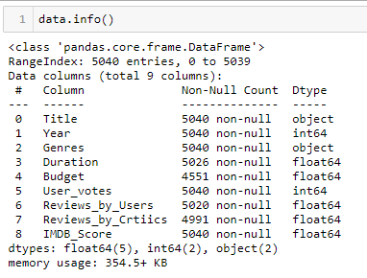
Title : shows the name of the movie
Year : shows the release year of the movie
Genre : describes the category of the movie
Duration : watch hours of the movie
Budget : amount of money invested in making of movie
User Votes : no of votes given to movie by user
Reviews by users : feedback given by the user
Reviews by critics : feedback given by the critics
IMDB Score : the overall rating by IMDB
There are 5 float variables, 2 integers and 2 object type variables.

Slide 12
DATA PRE-PROCESSING

Slide 13

DATA PRE-PROCESSING
The steps involved in this are as follows:
Loading the Data
Describing the Data
Analysing the Genre attribute
Checking missing value of each column
Replacing Missing values with median
Checking and dropping duplicate values
In the pre-processing of data, we start by studying the dataset and cleaning it as per our requirement.

Slide 14


Loading the data
Importing packages
Pandas is a high level data manipulation tool
NumPy is a python library used for working with arrays
Seaborn is a Python data visualization library based on matplotlib
Matplotlib is a library for creating static interactive visualizations
Loading the data set in DataFrame data type.
DataFrames allow you to store and manipulate tabular data in rows of observations and columns of variables.

Slide 15
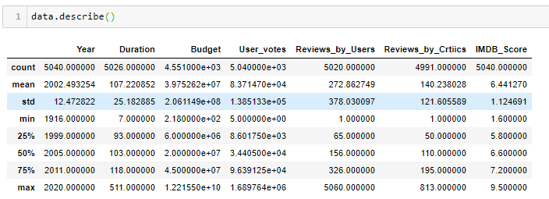
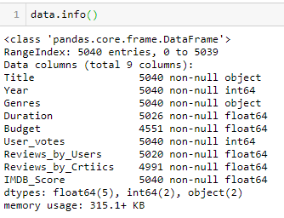
Describing the Data
Using describe() function to get a basic idea of all the int variable of data set
There are total of 7 attributes
The info() function is used to tell information about each and every attribute.
There are 2 object variablr
There are 2 int64 variable
There are 5040 rows entries
The total size of dataset is 315.1KB

Slide 16
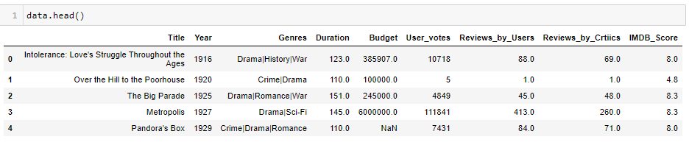
Using the head() function to get a basic idea about how the data is entered

Slide 17
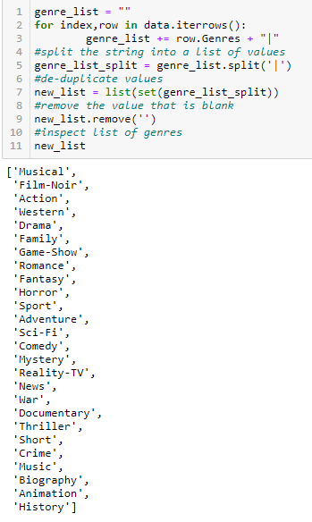
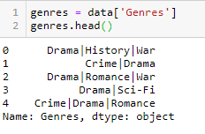
Analysing the Genre Attribute
In our dataset the Genre attribute contains values of object type.
Our motive is to segregate the different Genres in unique columns and convert it into int64 type.
So we iterate over the genre column and append all the unique genres into a list.

Slide 18
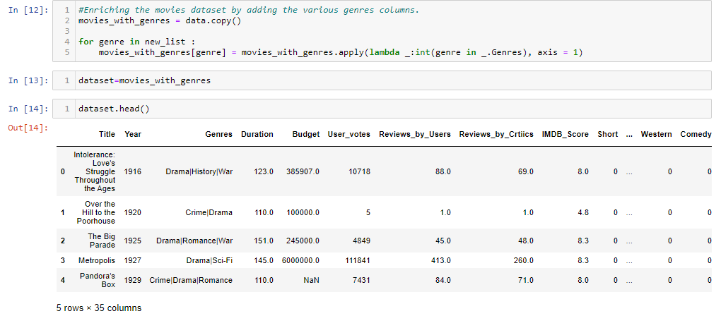
Now using the list we create column for each and every unique genre category and if the movie belongs to a particular genre then the value of column becomes 1 else 0

Slide 19
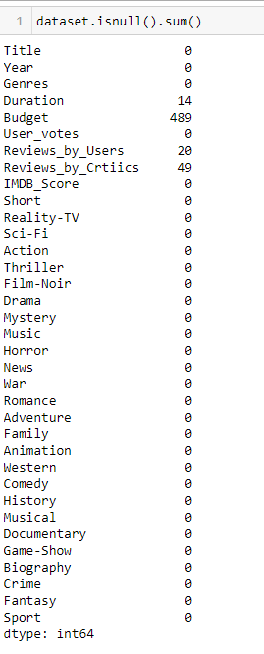
Checking the Null Value
Using isnull().sum() to check the total number of Null values in each column

Slide 20
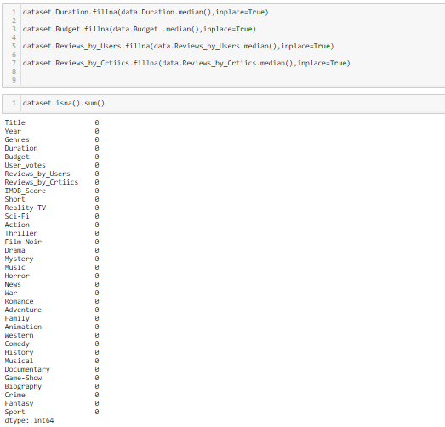
Replacing all the Null values of columns with the median of the attribute.

Slide 21
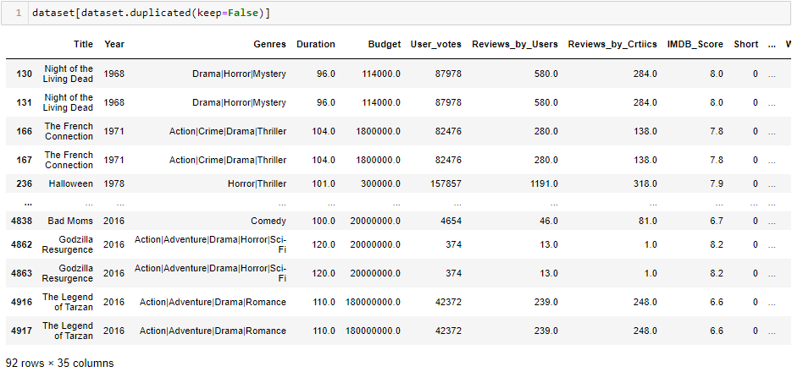
Checking duplicate values

Slide 22
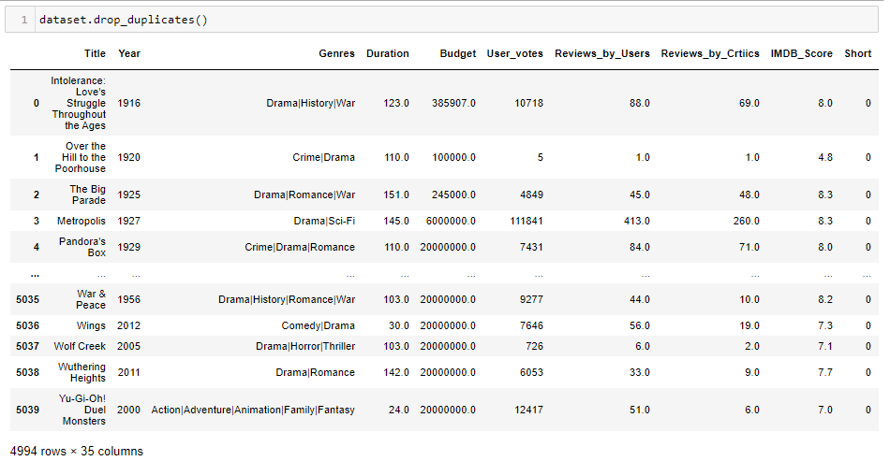
Dropping duplicate values

Slide 23
DATA VISUALIZATION

Slide 24
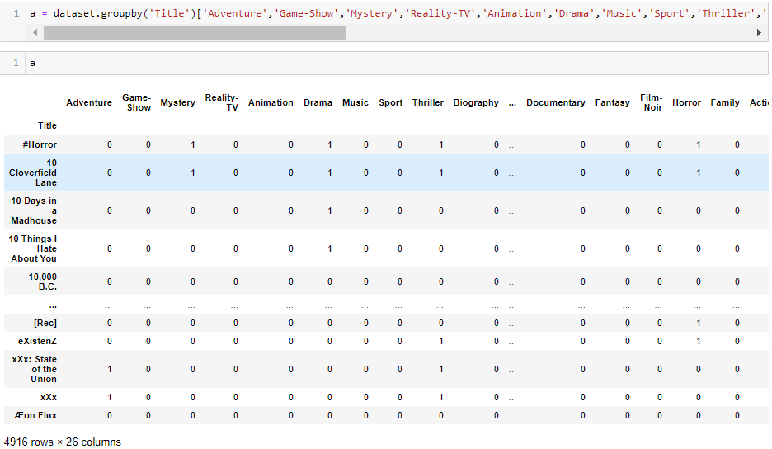
To calculate the number of movies in a particular genre we are grouping various genre categories by title using groupby()

Slide 25
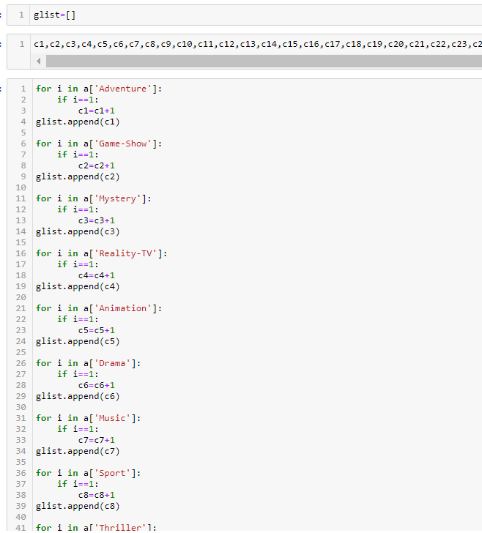
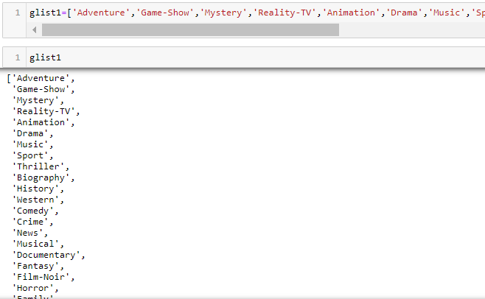
Here we are calculating the total number of movies in a particular genre
glist contains the number of movies
glist1 contains different genre names

Slide 26
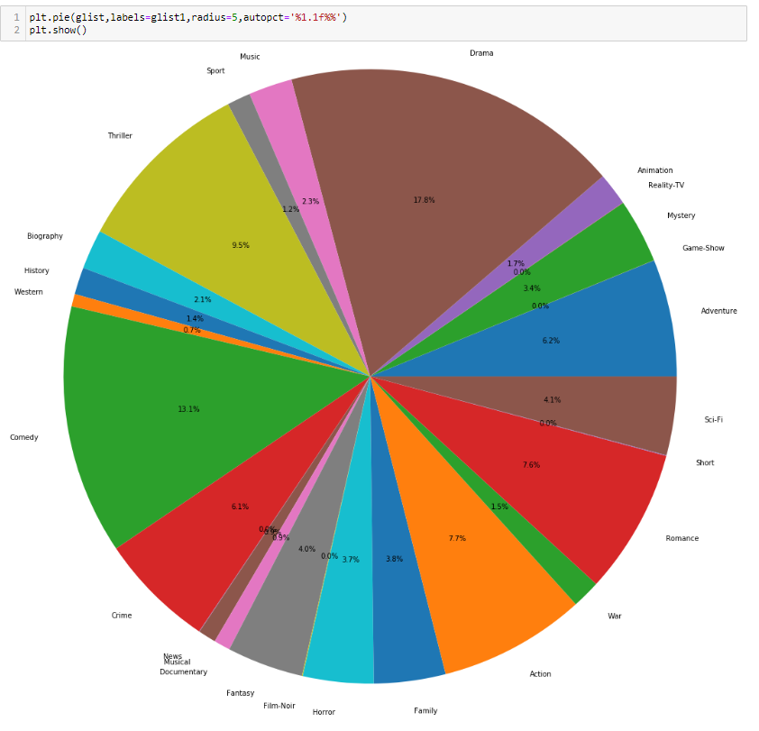
Pictorial representation of the number of movies in each genre

Slide 27
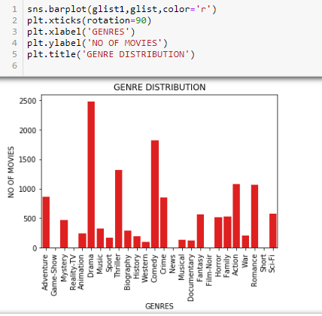
Bar Plot between the number of movies and genre

Slide 28
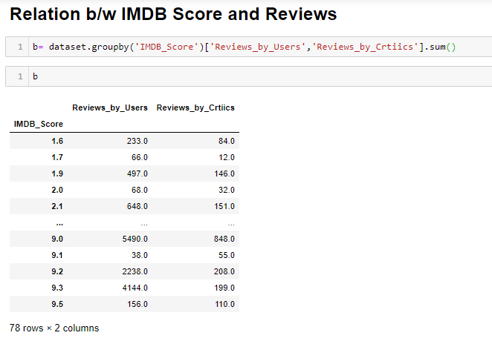
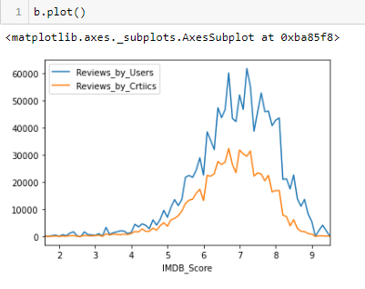
Plotting the reviews against IMDB Score
Grouping reviews by users and critics against IMDB Score using groupby()

Slide 29
MACHINE LEARNING MODEL

Slide 30
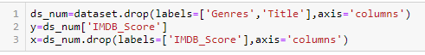
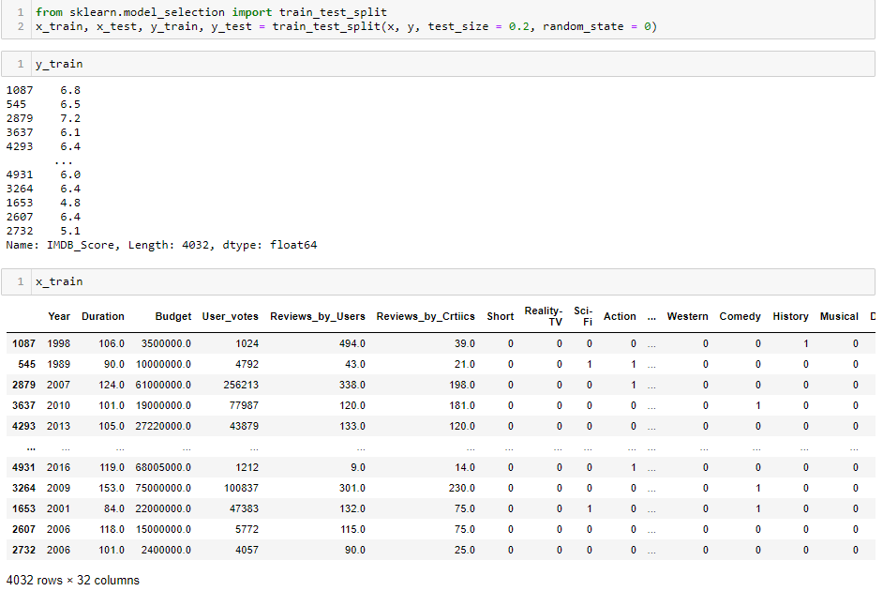
The first step towards building ML model is to define independent and dependent variables.
We are going to implement 4 Machine Learning Algorithms
Namely: Linear Regression
Decision Tree Classifier
Random Forest Classifier
Kneighbor Classifier
Logistic Regression
Then after comparison of accuracy score we can say which algorithm is best suited with our dataset
Then we have to make Testing and Training sets for both Dependent and Independent variable.

Slide 31
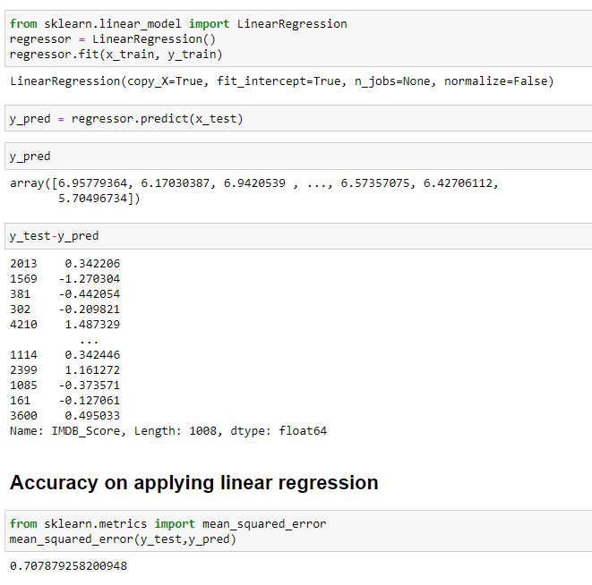
Linear Regression
Linear Regression is a supervised machine learning algorithm where the predicted output is continuous and has a constant slope. It’s used to predict values within a continuous range, rather than trying to classify them into categories
The accuracy comes out to be 70.78%

Slide 32
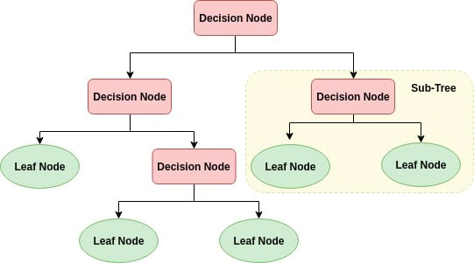
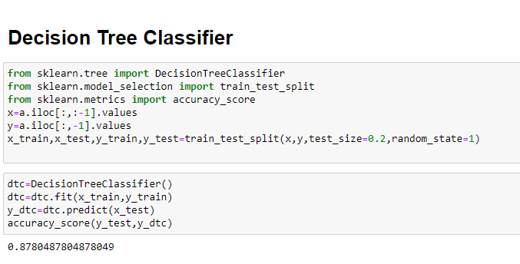
Decision Tree Classifier
Decision tree is a supervised learning method
It is used for classification and regression
It’s tree is a flowchart-like tree structure
It learns to partition on the basis of the attribute value
After importing the module and running the code we get ML code for our dataset
From accuracy_score() method we check the accuracy of our ML model
Which comes to be 87.80%

Slide 33
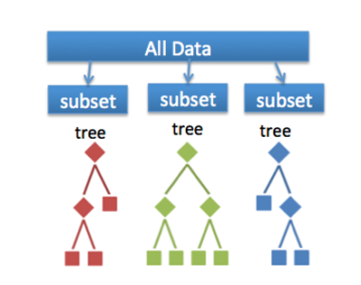
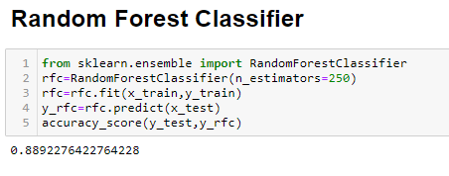
Random Forest Classifier
Random forests is a supervised learning algorithm.
It can be used both for classification and regression.
Random forests creates decision trees on randomly selected data samples.
Gets prediction from each tree and selects the best solution by means of voting.
After importing the module and running the code we get ML code for our dataset
From accuracy_score() method we check the accuracy of our ML model
Which comes to be 88.92%

Slide 34
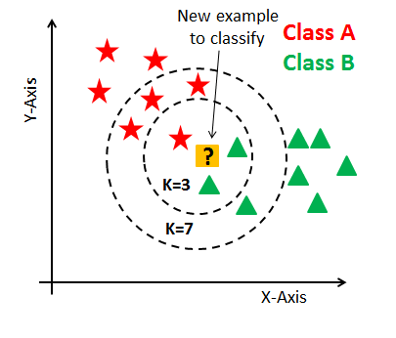
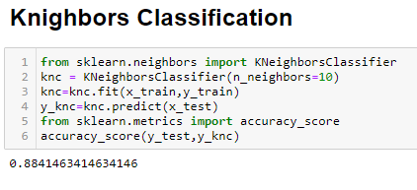
Kneighbors Classifier
K-Nearest Neighbors is a method that simply looks at the observation that are nearest to the one it’s trying to predict, and classifies the point of interest based on the majority of those around it
The number of neighbors is the core deciding factor.
After importing the module and running the code we get ML code for our dataset
From accuracy_score() method we check the accuracy of our ML model
Which comes to be 88.41%

Slide 35
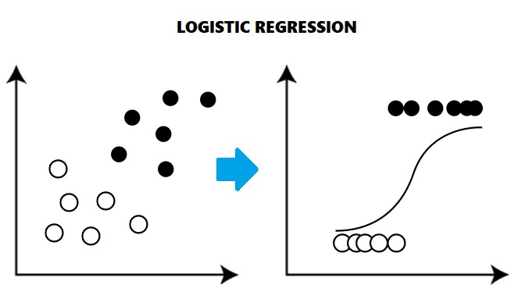
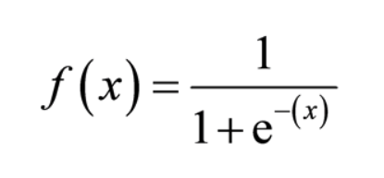
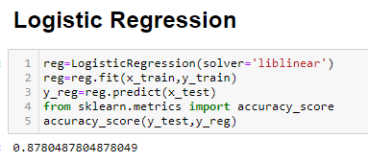
Logistic Regression
Logistic regression is a statistical method for predicting binary classes.
It can be used for various classification problems as its implementation is easy.
It uses Sigmoid function.
After importing the module and running the code we get ML code for our dataset
From accuracy_score() method we check the accuracy of our ML model
Which comes to be 87.80%

Slide 36
CONCLUSION
From this project we can conclude the accuracy of five Machine Learning Algorithms.
The accuracy of Linear Regression is 70.78%
The accuracy of Decision Tree Classifier is 87.80%
The accuracy of Random Forest Classifier is 88.92%
The accuracy of Kneighbors Classifier is 88.41%
The accuracy Logistic Classifier is 87.80%
The Random Forest Classifier is best suited on our dataset with the highest accuracy.

Slide 37
THANK YOU

